Slide 1

Weakly Supervised Object Localization (WSOL) Overview
-------------------------------------------------------------------------------------------------------------------------------------
CIS607 Computer Vision and
Deep Learning Seminar
-------------------------------------------------------------------------------------------------------------------------------------
Tyler Newton

Slide 2
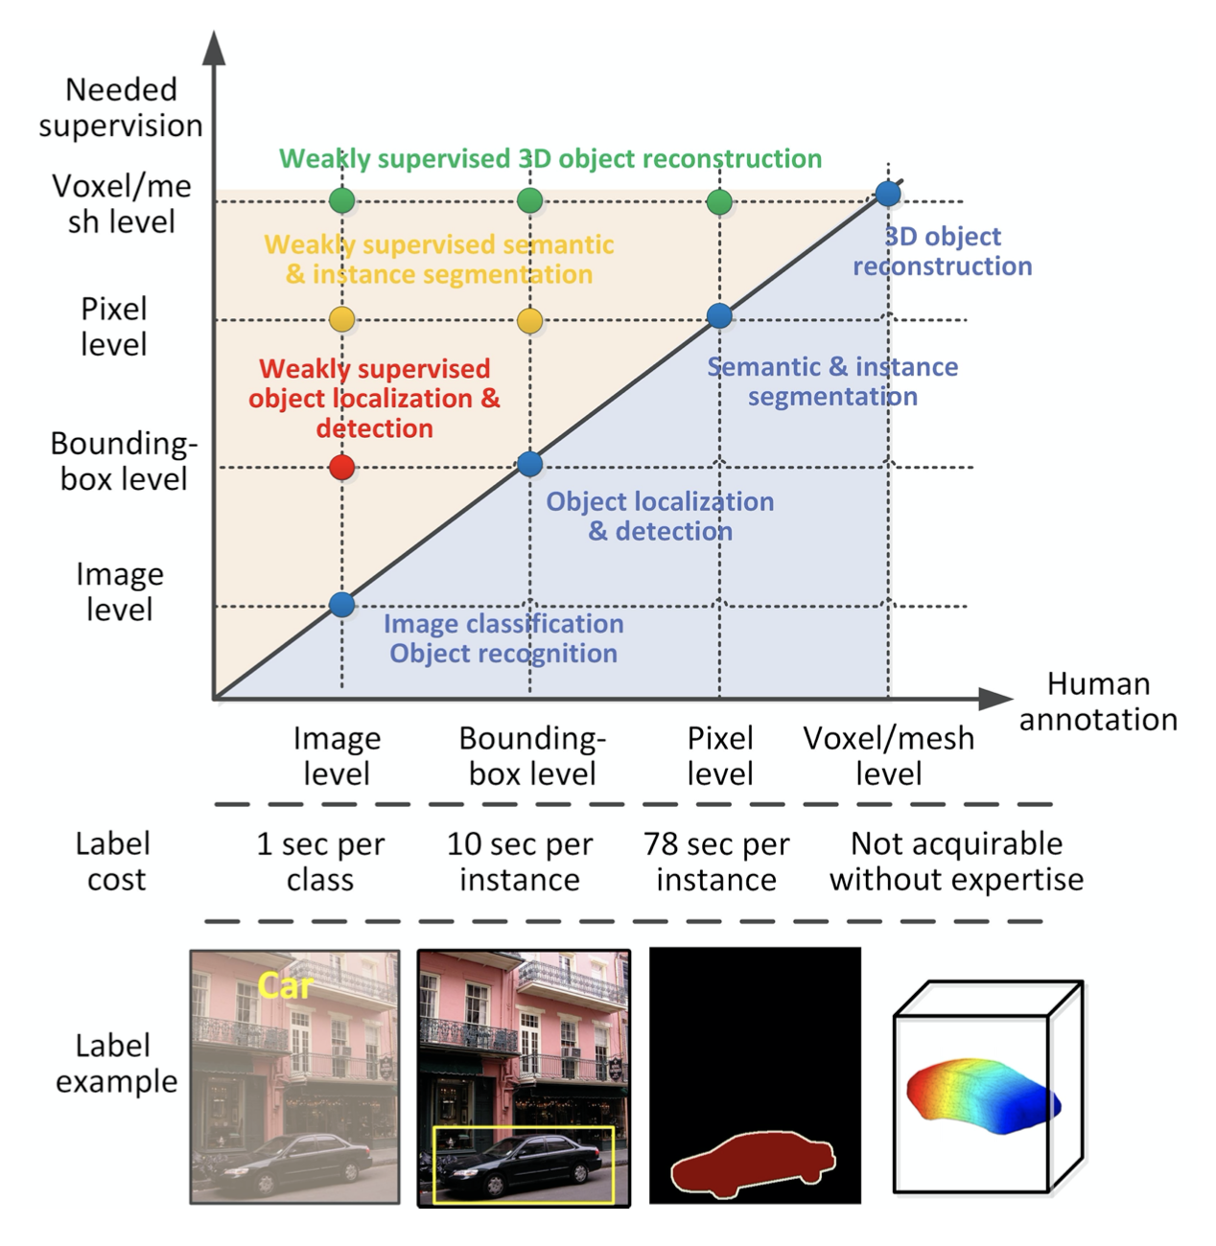
Weakly Supervised Object Localization (WSOL)
-training data are class labels
(image-level labels)
-no information on location
figure credit: Zhang et al. 2021
Notes:
annotation is lower degree of info than output

Slide 3
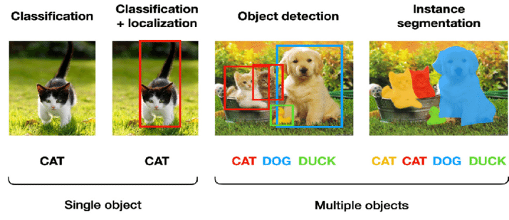
Weakly Supervised Object Localization (WSOL)
figure credit: Kang et al. 2020
Notes:
annotation is lower degree of info than output

Slide 4
Weakly Supervised Object Localization (WSOL)
ill-posed
input: image-level
output: instance-level
figure credit: Kang et al. 2020
Notes:
annotation is lower degree of info than output

Slide 5
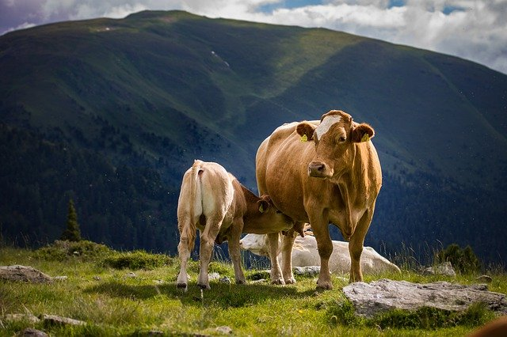
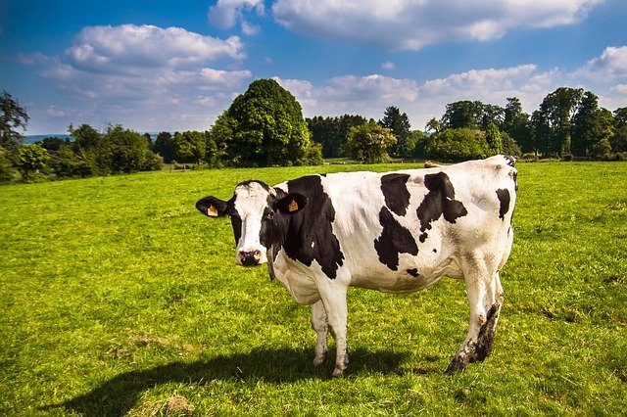
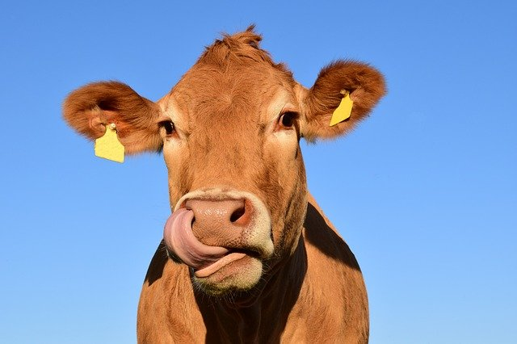
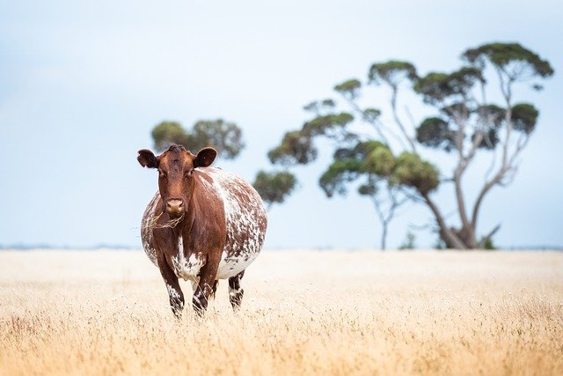
Challenges of WSOL
The usual suspects:
clutter
intra-class variance
occlusion
Mapping from class to location:
part vs whole
background vs object
concurrence
Notes:
like viewpoint, scale, aspect ratio
Set of features that represent class -> set of feat that represents the extent of each instance of a class

Slide 6
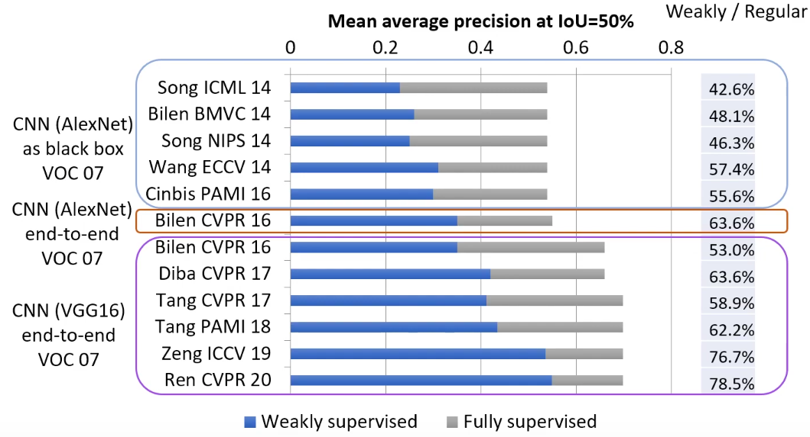
Motivation/Cost of WSOL
Save labeling time at the expense of performance.
figure credit: Zhang et al. 2021
figure credit: Bilen ECCV 2020
Notes:
like viewpoint, scale, aspect ratio

Slide 7
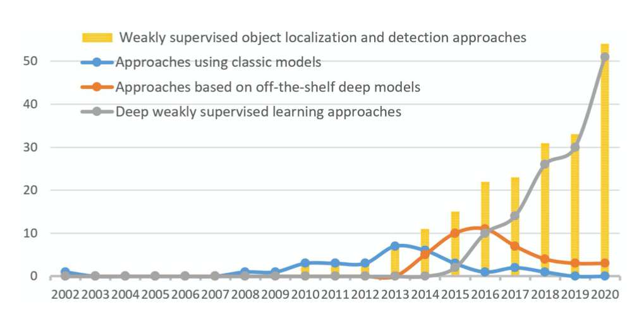
Three main frameworks
classic approaches (feature engineering)
clever initialization methods
clever refinement methods
OTS feature representations
pre-trained deep features
inherent cues in deep models
deep learning frameworks
single-network
multi-network
figure credit: Zhang et al. 2021
Notes:
Domain knowledge to extract features

Slide 8
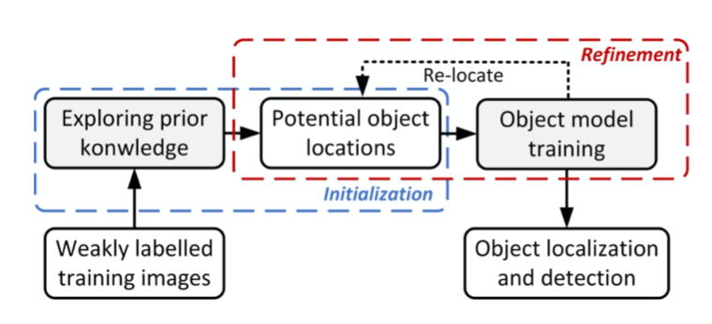
Classic approaches
figure credit: Zhang et al. 2021
Initialize 2. Refine 3. Detect
Initialization of region proposals:
selective search (van de Sande, ICCV 2011)
graphs (Song, ICML 2014)
negative mining (Siva, CVPR 2013)
etc., some type of information cue on candidate object regions
Refine:
score region proposals in some way & iterate
one positive instance per proposal (relax-max, nms)
HOG, SIFT, etc.
Deformable Parts Model, SVM
Notes:
mine reliable instance samples
Non-max suppression
Histogram of oriented gradients, scale invariant feature transform
Support vector machine

Slide 9
Classic approaches
figure credit: Zhang et al. 2021
Initialize 2. Refine 3. Detect
Initialization of region proposals:
selective search (van de Sande, ICCV 2011)
graphs (Song, ICML 2014)
negative mining (Siva, CVPR 2013)
etc., some type of information cue on candidate object regions
Refine:
score region proposals in some way & iterate
one positive instance per proposal (relax-max, nms)
HOG, SIFT, etc.
Deformable Parts Model, SVM
The building blocks of other models
Notes:
mine reliable instance samples

Slide 10
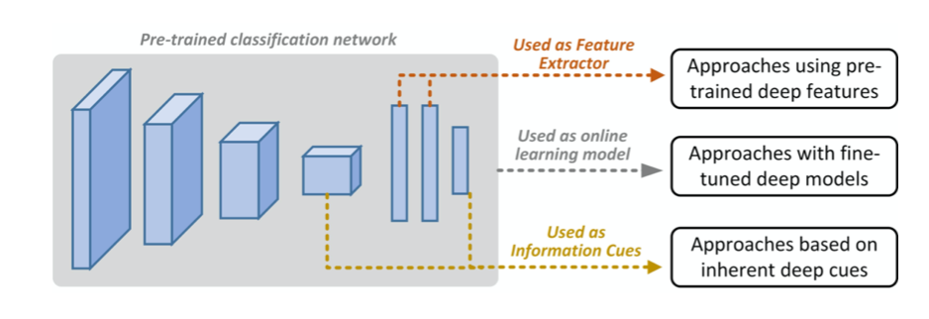
Feature representations from off-the-shelf models
Pre-trained deep features
use pre-trained models as feature extractors (DeCAF, MIL)
Gonthier 2018, Zadrija CVIU 2018, etc.
Inherent cues in deep models
network layer activations and semantic scores
Li ISPRS 2018, Wilhelem DICTA 2017, etc.
Fine-tuned deep models
tune OTS models during weakly supervised learning
Zhang IJCV 2019, Shi ICCV 2017, Singh CVPR 2016, etc.
figure credit: Zhang et al. 2021

Slide 11
End-to-end deep weakly supervised learning
Single-network training
object regions from end-to-end learning via layers for instance inference and propagation of image labels
outputs vary 🧐: semantic scores (Wu, Bilen), CAM maps (Zhou), bounding boxes, point
Huang NIPS 2020, Shen CVPR 2020, Mai CVPR 2020, Jiang ICCV 2019, … , many others…, Wu CVPR 2015, …
Multi-network training
one network to mine initial object regions
another network for detection via MIL framework
sometimes another final object detection network (Fast[er] RCNN)
Zhang CVPR 2020, Zhong ECCV 2020m Kosugi ICCV 2019, …, Zhang TGRS 2016, etc.
SOA despite lack of engineered features like bbox regression, negative mining, etc.
Notes:
First in 2016 by Bilen, SOA

Slide 12
Evaluation metrics
via PASCAL VOC, ImageNet, and CUB datasets:
CorLoc metric – bounding box with highest class score has >= 50% overlap
with ground-truth bounding box (requires a ground-truth, but
remember this is WSOL)
mAP metric – mean IOU if IOU with ground-truth is > 50%
Other metrics: GT Loc, Top-1 Loc, Top-5 Loc
Good luck

Slide 13
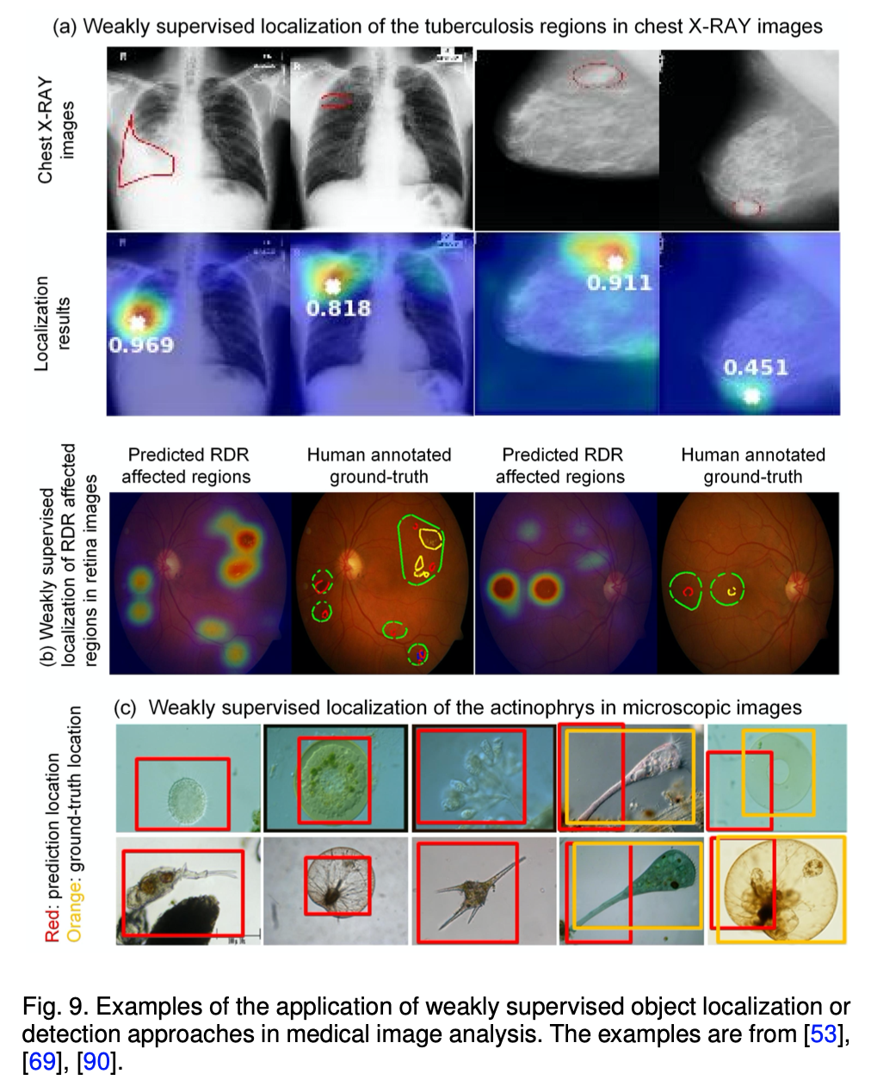
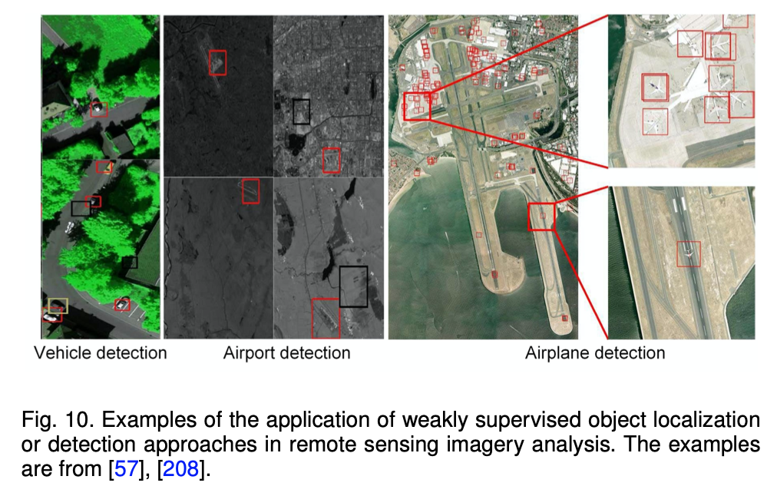
Use cases
figure credits: Zhang et al. 2021

Slide 14
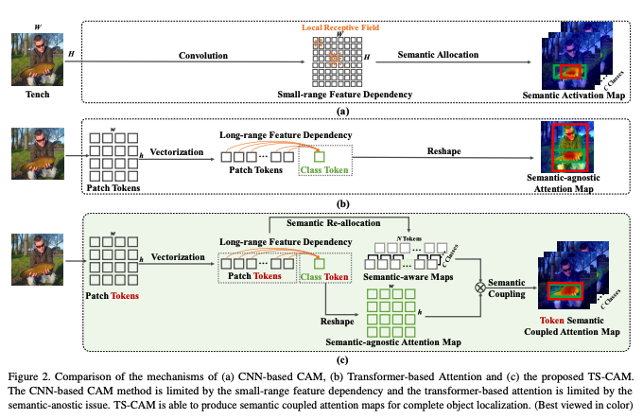
CAM methods are popular
CAM on OTS CNN models:
struggle with global cues
convolutions produce localized receptive fields leading to partial activation
Layer-CAM (Jiang et al. 2021) tries to solve this by sampling shallow layers
Transformers to the rescue:
TS-CAM (Gao et al. 2021) token semantic
coupled attention maps via visual
transformer

Slide 15
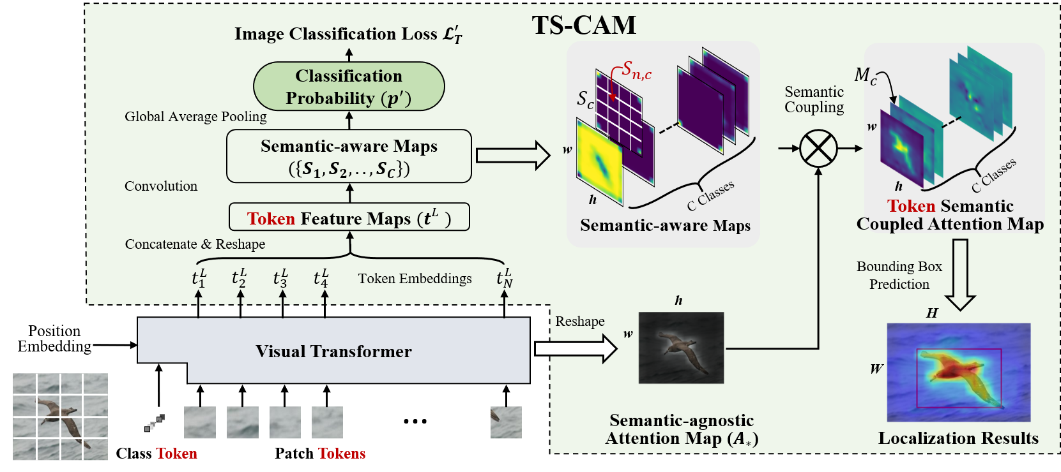
TS-CAM: Token Semantic Coupled Attention Map for Weakly Supervised Object Localization
https://github.com/vasgaowei/TS-CAM

Slide 16
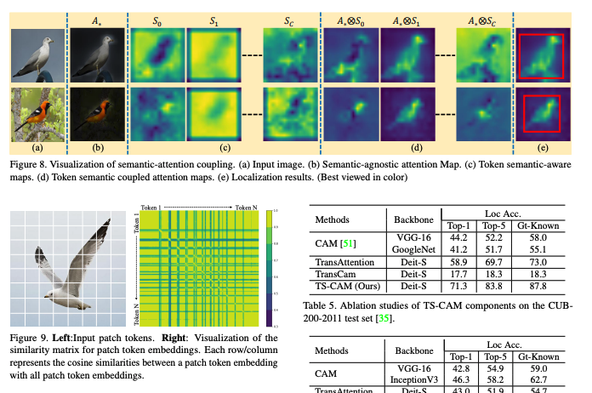
TS-CAM: Token Semantic Coupled Attention Map for Weakly Supervised Object Localization
figure credits: Gao et al. 2021

Slide 17
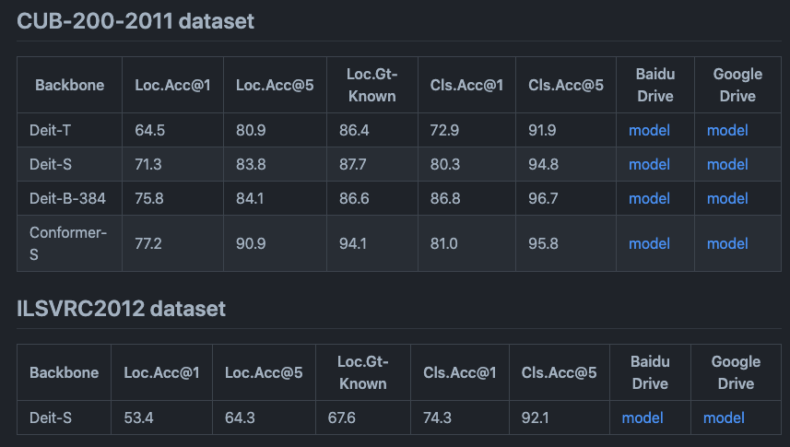
TS-CAM: Token Semantic Coupled Attention Map for Weakly Supervised Object Localization
https://github.com/vasgaowei/TS-CAM

Slide 18
ECCV 2020 Tutorial on Weakly-Supervised Learning in Computer Vision
A great resource:
https://hbilen.github.io/wsl-eccv20.github.io/

Slide 19
Weakly Supervised Object Localization and Detection: A Survey, Zhang et al. 2021
A great review paper:
https://doi.org/10.1109/TPAMI.2021.3074313

Slide 20
Takeaways: - methods that require initialization are sensitive to that choice and prone to overfitting - end-to-end networks are SOA - performance compared to standard supervision is ~70-80% in best cases Let’s demo 💻
https://github.com/vasgaowei/TS-CAM/blob/master/tools_cam/visualization_attention_map_imaget.ipynb
https://github.com/yeezhu/SPN.pytorch/blob/master/demo/EvaluationDemo.ipynb
Fake HW:
https://github.com/g41903/ObjectLocalization-WeaklySupervised

Slide 21
Extra slides

Slide 22
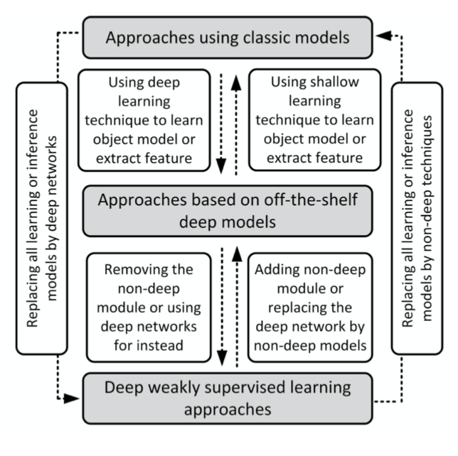
figure credit: Zhang et al. 2021

Slide 23
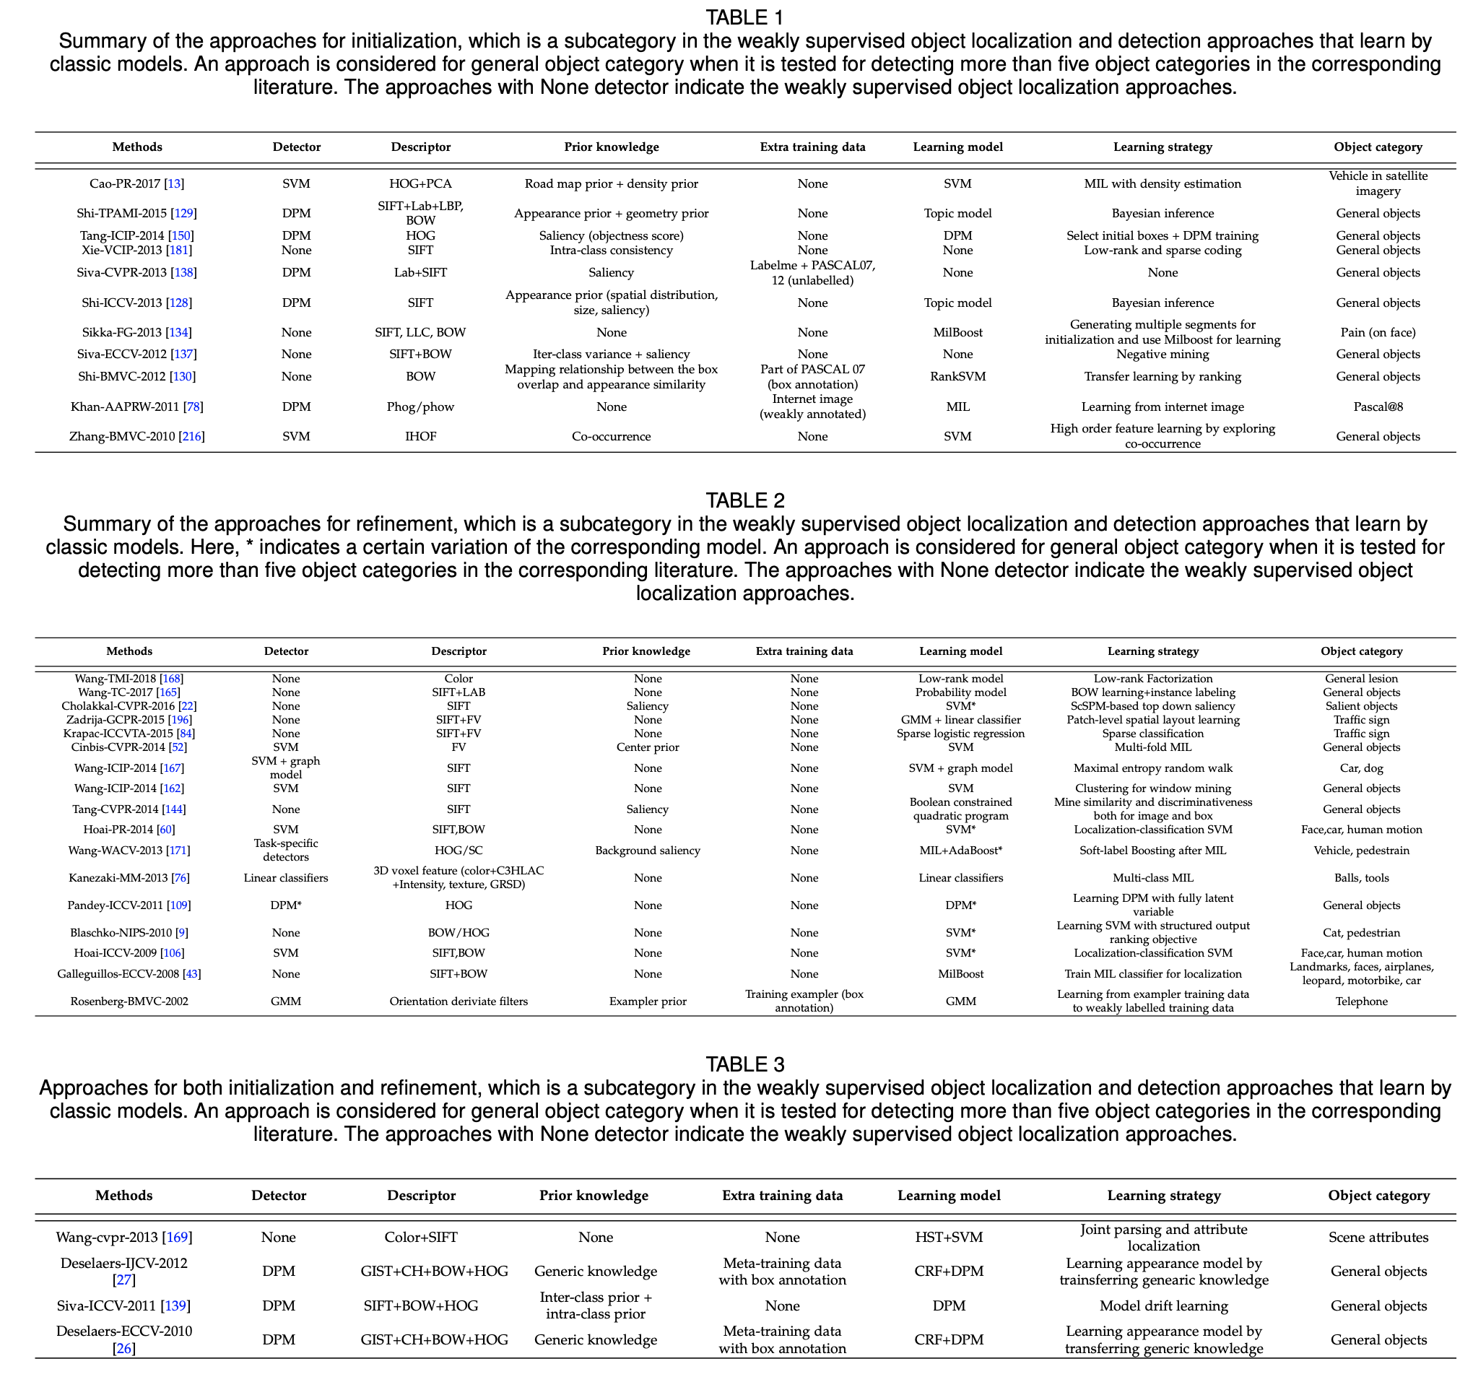
figure credit: Zhang et al. 2021

Slide 24
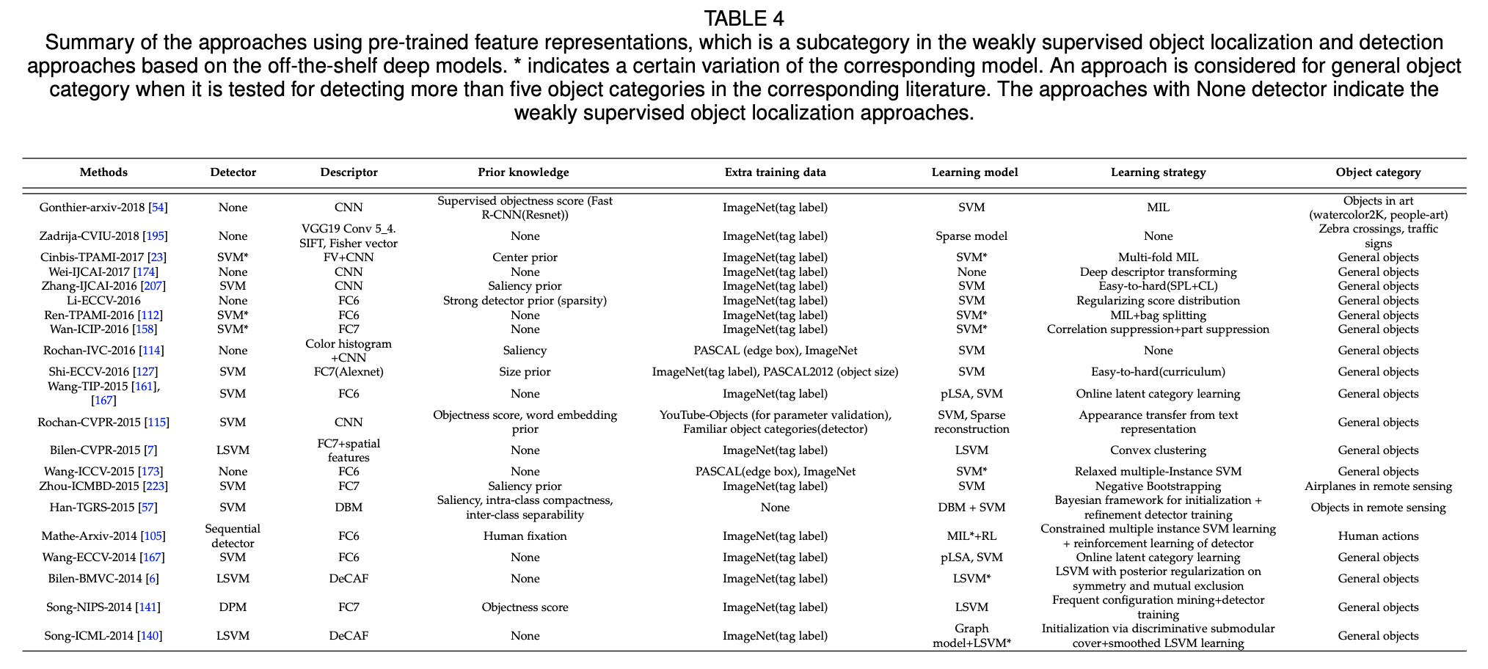
figure credit: Zhang et al. 2021

Slide 25
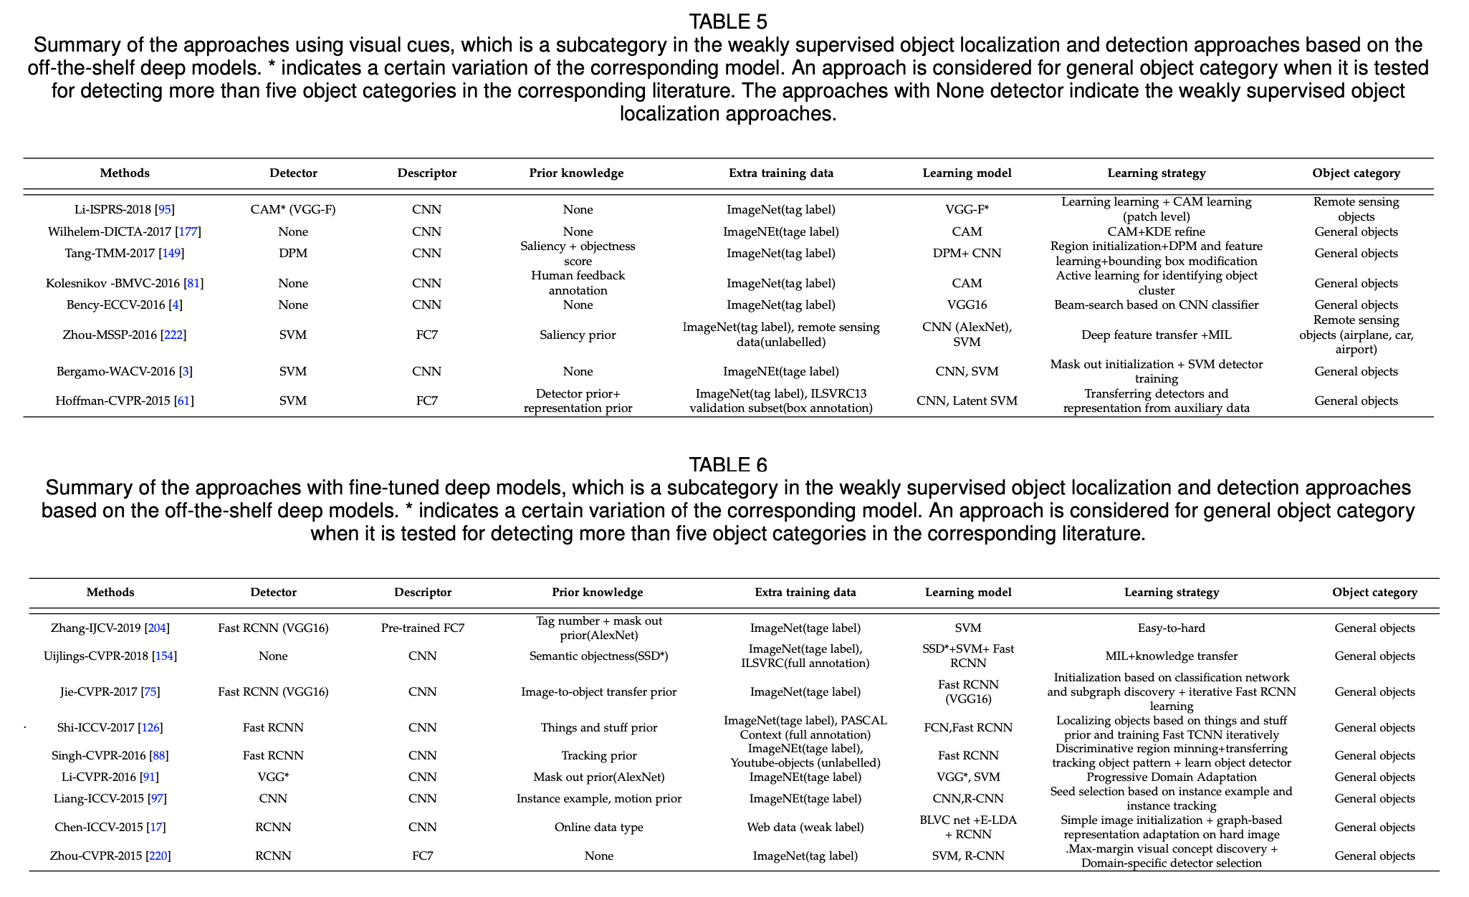
figure credit: Zhang et al. 2021

Slide 26
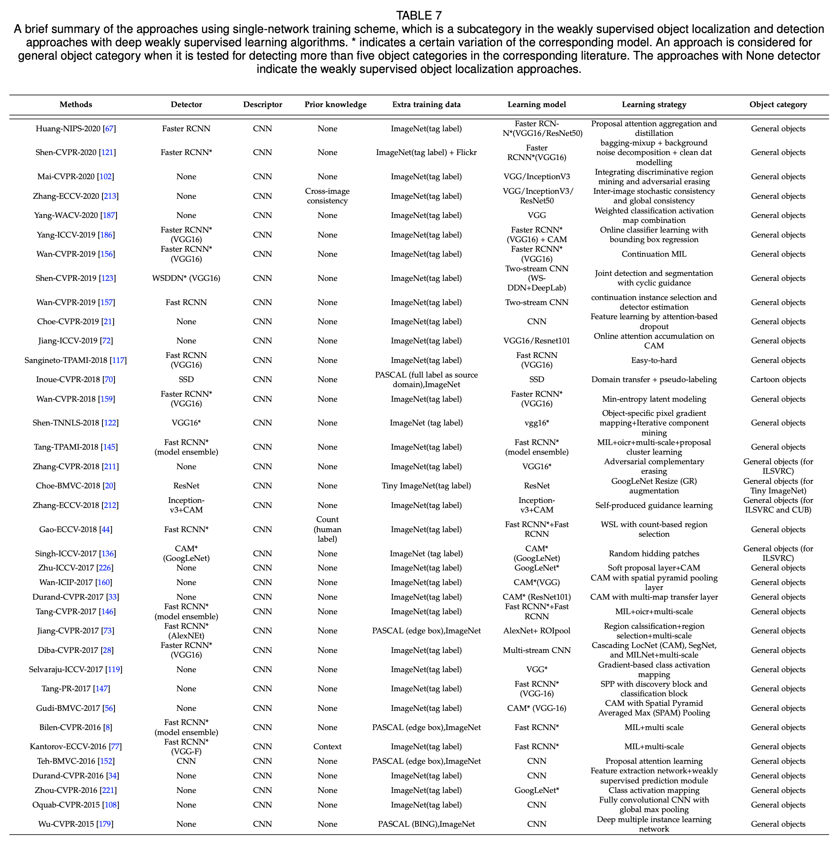
figure credit: Zhang et al. 2021

Slide 27
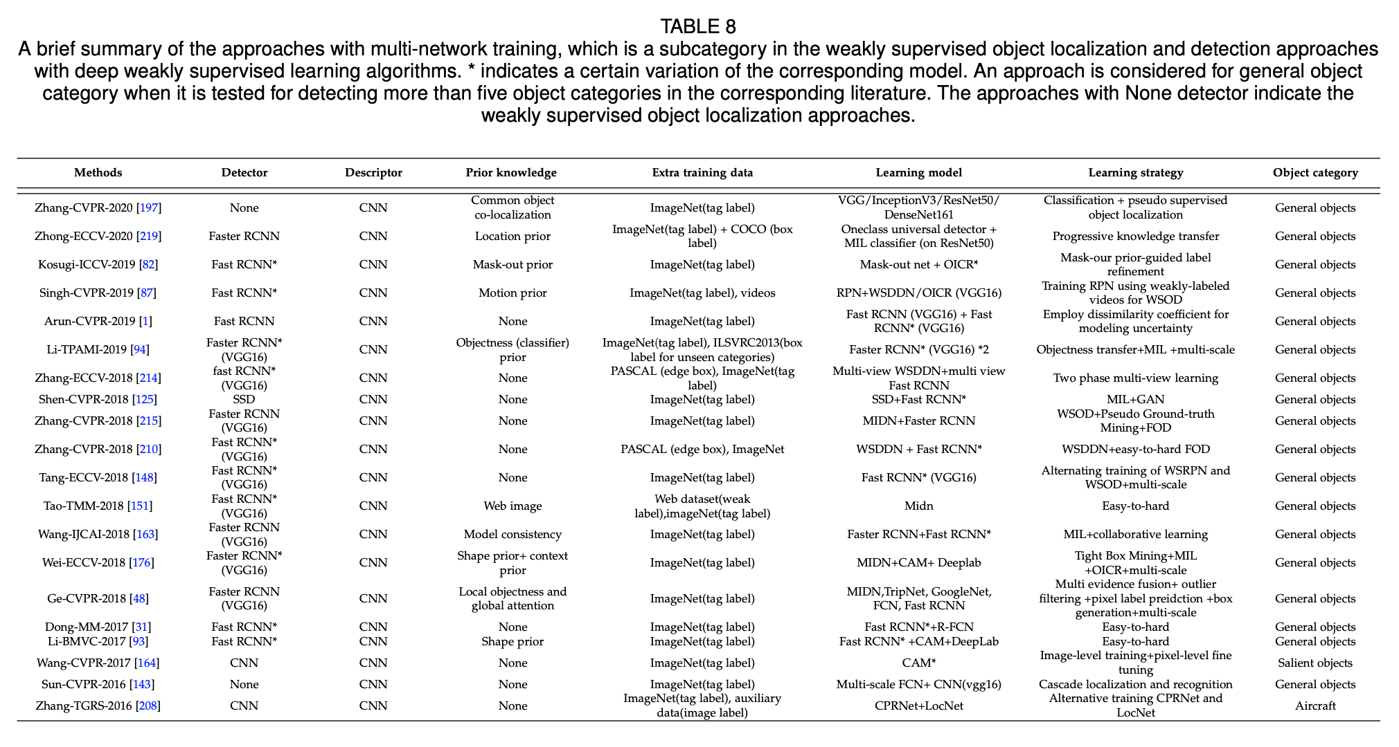
figure credit: Zhang et al. 2021

